Slide 1
Miguel Viedma
Group Legal VP / Digital and Business Innovation
Capgemini

Slide 2
Legal Challenges of AI and IoT- Index
The 4th Industrial Revolution
Artificial Intelligence
Internet of Things
Contractual Approach

Slide 3
The 4th Industrial Revolution (I)
“We stand on the brink of a technological revolution that will fundamentally alter the way we live, work, and relate to one another”
Klaus Schwab
Founder and Executive Chairman, World Economic Forum
Artificial Intelligence
Machine Learning
Algorithmic collusion
Internet of Things
Connected vehicles
Roboticss
Steam Power
Wearable devices
3D printing
5G
Electricity
Augmented Reality
Blockchain
Big Data
Information Technology
Smart Contracts
Quantum Computing
ubiquitous computing
Cyber physical system
LOGO

Slide 4
The 4th Industrial Revolution (II)- some figures
Global Spending in IoT is expected to reach $1.3 Trillion by 2020 (IDC)
IoT Security Spending will reach $ 2.4 Billion by 2020 (Gartner)
4 Billion connected people by 2020 (IDC)
Over 26 Billion connected devices by 2020 (IDC)
50 Trillion GBs data generated last year
70% of consumers now use channels like online, mobile and social media in their shopping journey (Capgemini Consulting)
By 2020 50% of all searches on internet will be voice searches (Wix)
Global revenues from AI for enterprise applications is projected to grow from $1.62B in 2018 to $31.2B in 2025 (Forbes)

Slide 5
Artificial Intelligence (AI)
The science and engineering of making intelligent machines, especially intelligent computer programs“ (John McCarthy)
Not something “that new “ – IBM’s Deep blue in 1996.
From purely “Reactive” to “Self-aware”.
Evolution propelled by the combination of data, computing capacity and connectivity and the confluence of 4 advancing technologies.
Machine Processing
Machine Learning
Machine Perception
Machine ControI

Slide 6
AI- Legal Framework Reference
Under construction -
European Parliament resolution of 16 February 2017, with recommendations to the Commission on Civil Law Rules on Robotics (2015/2103(INL)).
Regulatory Agency
Electronic legal personality
Responsibility
Compensation Fund
Ethic Code
Security by Design
IP
Tax and Social Security
Areas that may be impacting current laws (eg Product Liability Directive or GDPR)

Slide 7
Internet of Things (IoT)
Concept of connecting any device to the Internet (and/or to each other) and their ability to send and receive data via the Internet.
Not something “that new “ – ATM's, some of the first IoT starting back in 1974
Consumer Internet of Things (CIoT)
Smart home automation (e.g. smart thermostats),
Personal healthcare (e.g. wearable health trackers and fitness devices),
Entertainment (e.g. smart TV and virtual reality headsets),
Home appliances,
Connected vehicles, etc
Industrial Internet of Things (IIoT)
Waste management,
Smart lighting,
Connected manufacturing devices,
Logistics, etc

Slide 8
IoT - Legal Framework Reference
Lacking a unified legal corpus.
Diversity of aspects impacted by the development of IoT:
Interconnectivity
Standardization
Use of platforms
Data Protection
Cybersecurity
IP
Some of the relevant initiatives and legislation within the EU scope:
Horizon 2020 Work Programme - Internet of Things large scale pilots. EU Commission, 2016-2017
The Directive on security of network and information systems (NIS Directive), 2016
Single Digital Market Strategy, 2015
GDPR

Slide 9
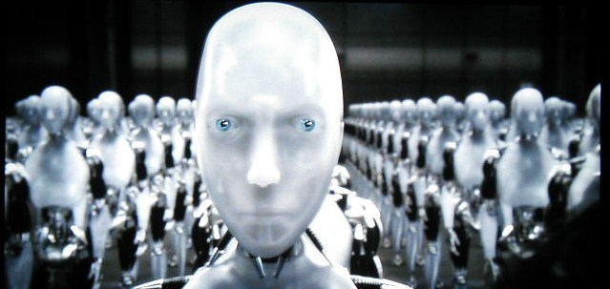
Contractual Approach (I)
For the time being... not a legal person.
But rather a combination of:
Data + Hardware + Software
Complexity due to the number of actors involved:
Manufacturer HW/device
SW Developer/App Developer
Manufacturer/parts
Platform provider
Network Provider
Regulator
End user
Third parties

Slide 10
Contractual Approach (II)
4 important areas to watch out:
Liability
Data protection and Privacy
Cybersecurity
IP
Contractual approach not too different to other IT/Technology projects :
Risk Analysis/Due diligence
Applicable Laws, contractual structure (self executing, contracting entity), our position in the "chain“ and within the ecosystem, potential heads of loss , potential claimants (interaction with end users) regulatory aspects, data protection , insurance, etc
Contractual Protection
Limitations and exclusions of liability, Force Majeure, Data Protection, flow down of T&C (3rd party elements /rights), warranties ("As is“, reasonable endeavors,, “end result”?), acceptance process, etc
Mitigation Plan
Legal to be part of the solution design phase, Governance and internal control mechanism, control of product design and end use, tracking of regulatory evolution.

Slide 11
MANY THANKS

